Slide 1
Data Centric RAD
Bachelor of Science (Honours) in Computing in Software Development
Bachelor of Science in Computing in Software
Development
Department of Computer Science & Applied Physics

Slide 2
JSF – Java Server Faces
JSF (JavaServer Faces) is a server-side user interface (UI) component framework for Java technology-based web applications.
JSF is based on the MVC (Model View Controller) web framework that simplifies the construction of web applications in Java.

Slide 3
JSF - Background
Applet
Java program which is downloaded with a web page.
As the applet is usually embedded in an HTML page on a Web site it can be executed from within a browser.
Servlet
A Java applet that's designed to run on a server, rather than on a web browser.
Faces
Whereas a servlet controls the back-end sequence of requests to and from a server, Faces define the user interface.
Faces act as the public face of the application and are commonly used alongside servlets.

Slide 4
Why JSF?
JSF is the Standard way of building web application UIs in Java – supported by Oracle.
JSF offers a clean separation between behaviour and presentation for web applications.
A JSF application can map HTTP requests to specific event handling components on the server allowing you to build web applications that implement the finer-grained separation of behaviour and presentation that is traditionally offered by client-side UI architectures.
Large number of reusable UI components.
Extendable – Many 3rd party libraries such as OpenFaces and PrimeFaces have extra functionality.
Easy to process and validate form data.

Slide 5
JSF
The main components of JSF are:
An API for representing UI components and managing their state; handling events, server-side validation, and data conversion; defining page navigation; supporting internationalization and accessibility; and providing extensibility for all these features
Two custom tag libraries for expressing UI components within a JSP page and for wiring components to server-side objects
h - This tag library contains JSF component tags for all UI Components defined in JSF
f - The core JavaServer Faces custom actions

Slide 6
JSF Components
A set of web pages to layout UI components.
A set of ManagedBeans.
A web deployment descriptor (web.xml).

Slide 7
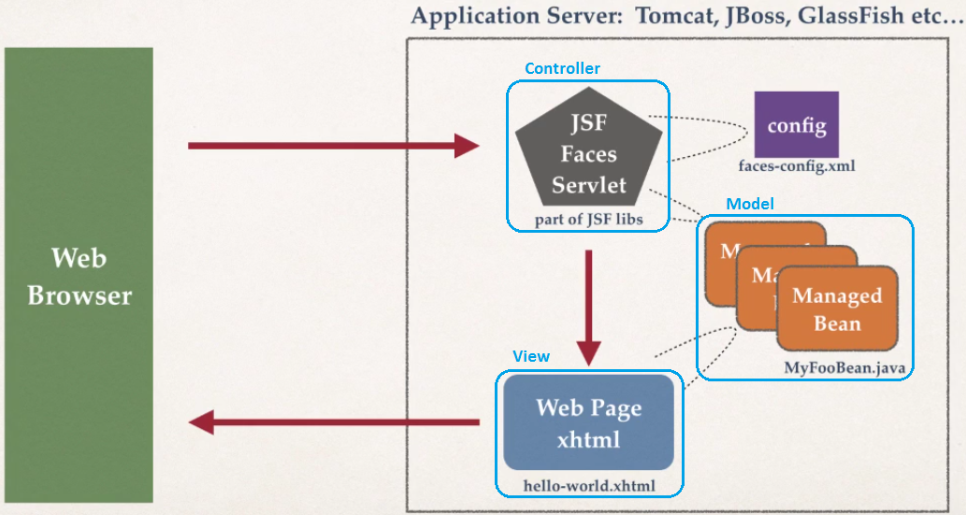
JSF Architecture

Slide 8
Application Server Support
Application Servers such as JBoss Wildfly 8 and Glassfish 4 have full JSF 2.2 support.
In Tomcat 9, the JSF libraries need to be added manually.

Slide 9
JSF Tags
JSF simplifies building UIs by using tags.
The h library contains all the JSF UI tags such as:
button
dataTable
form
inputText
To use the h library’s UI tags include a link to the xml namespace:
xmlns:h="http://xmlns.jcp.org/jsf/html"

Slide 10
JSF Tags
The f library contains general purpose tags for selection, conversion, validation, Ajax etc.
A Common f tag is f:selectItem which adds a select item component to a UI component, for example a Radio Button or a Drop down list.
The most frequently used attributes of selectItem are
itemValue – the reference to the item in the code
itemLabel – the text displayed to the user:
<f:selectItem itemValue="Red" itemLabel="Red" />
To use the f library’s UI tags include a link to the xml namespace:
xmlns:f="http://xmlns.jcp.org/jsf/core"

Slide 11
JSF Tags
JSF supports HTML5 by not introducing new UI components that duplicate HTML5 ones but by allowing you to use HTML5 markup directly.
For example, the HTML5 attribute placeholder is associated with an input element.
This attribute is not duplicated in JSF, but the placeholder attribute can still be used.

Slide 12
JSF Pass-Through Attributes
Pass-through attributes are not interpreted by JSF but are passed through to the browser where they are interpreted or rendered.
Pass-through attributes are defined using the following xml namespace:
xmlns:p=http://xmlns.jcp.org/jsf/passthrough

Slide 13
Using a JSF tag with a pass-through attribute
Define the UI and pass-through namespaces:
<html xmlns="http://www.w3.org/1999/xhtml"
xmlns:h="http://xmlns.jcp.org/jsf/html"
xmlns:p="http://xmlns.jcp.org/jsf/passthrough">
<h:inputText p:placeholder=“Enter your name”/>

Slide 14
JSF Tags - commandButton
h:commandButton renders an HTML element as follows:
<input type=“submit”
The action attribute of the h:commandButton can specify a page to navigate to (without the .xhtml extension):
<h:commandButton value="OK" action=“page2”>
</h:commandButton>
h:commandButton must be in a h:form

Slide 15
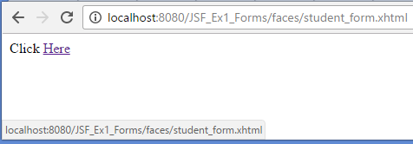
JSF Tags - outputLink
The h:outputLink tag renders an HTML a element.
The output attribute specifies the webpage to navigate to:
Click <h:outputLink value="student_form.xhtml">Here</h:outputLink>

Slide 16
JSF Tags - selectOneRadio
The h:selectOneRadio tag renders an HTML input element of type radio.
xmlns:f="http://xmlns.jcp.org/jsf/core"
For example given the following Radio Button one of three possible values to select:
<h:selectOneRadio value="#{myColour}">
<f:selectItem itemValue="R" itemLabel="Red" />
<f:selectItem itemValue="G" itemLabel="Green" />
<f:selectItem itemValue="B" itemLabel="Blue" />
</h:selectOneRadio>
The value of myColour will be either R, G or B.

Slide 17

JSF Tags - selectOneMenu
The h:selectOneMenu tag renders an HTML select element.
For example given the following Radio Button one of three possible values to select:
<h:selectOneMenu value="#{myColour}">
<f:selectItem itemValue="R" itemLabel="Red"/>
<f:selectItem itemValue="G" itemLabel="Green"/>
<f:selectItem itemValue="B" itemLabel="Blue"/>
</h:selectOneMenu>
The value of myColour will be either R, G or B.

Slide 18
JSF Bindings
JSF uses Expression Language to manage variable bindings:
#{variable} gets or sets the value of variable
For example:
<h:inputText value=“#{name}” p:placeholder=“Enter your name”/>
Binds the value of what ever is input in the inputText to the variable name

Slide 19
JSF Bindings
name can then be displayed in another webpage by simply using the EL syntax:
#{name}

Slide 20
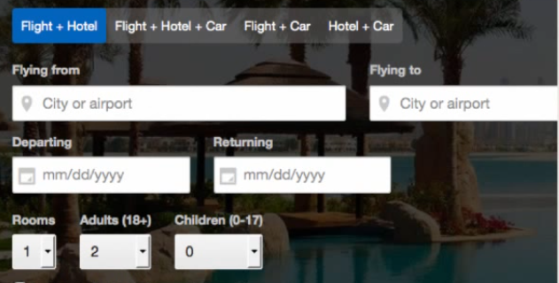
JSF Forms
JSF components will generate HTML forms
JSF UI Component | Description
h:form | Main Form Container
h:inputText | Text Field
h:inputTextarea | Multi-line Text Field
h:selectBooleanCheckBox | Check Box
h:selectOneRadio | Radio Buttons

Slide 21
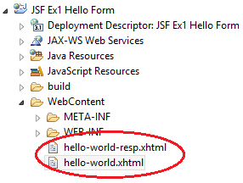
JSF Hello World Application
In JSF, web pages have the extension .xhtml
To run, right-click on web page and select Run As/Run on Server
All Web Pages are in WebContent Folder

Slide 22


hello-world.xhtml
<!DOCTYPE html>
<html xmlns="http://www.w3.org/1999/xhtml"
xmlns:h="http://xmlns.jcp.org/jsf/html"
xmlns:p="http://xmlns.jcp.org/jsf/passthrough">
<h:head>
<title>JSF Hello World Web App</title>
</h:head>
<h:body>
<h:form>
Name: <h:inputText value="#{name}" p:placeholder="Enter your name"/>
<h:commandButton value="OK" action="hello-world-resp“/>
</h:form>
</h:body>
</html>

Slide 23

hello-world-resp.xhtml
<!DOCTYPE html>
<html xmlns="http://www.w3.org/1999/xhtml"
xmlns:h="http://xmlns.jcp.org/jsf/html">
<h:head>
<title>JSF Hello World Web App - Response Page</title>
</h:head>
<h:body>
Hello World from #{name}
</h:body>
</html>

